Slide 1
Final Presentation
Task 4: Market-based task allocation with heterogeneous team of robots
Groupe 8
Jacques Benand
Lucas Maneff
Paul Richard
Introduction
Centralized
Distributed
Conclusion
Notes:
Welcome !

Slide 2
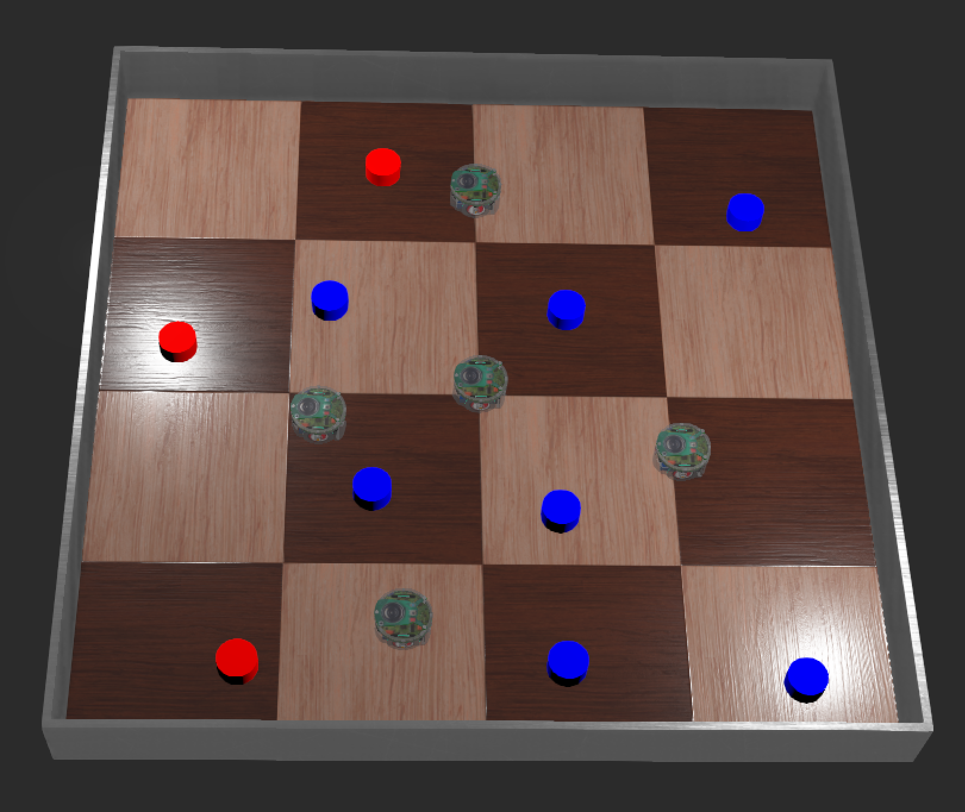
Introduction : World and Scenario
Natural Disaster with several victims :
Medical treatment ⇒ Task A: Red
Psychological support ⇒ Task B: Bleu
Fleet of robot to assist them:
Specialized ( 2 task A, 3 task B)
2 min of energy
Goal :
Maximize assistance delivered in 3 min
Test multiple market based method
Introduction
Centralized
Distributed
Conclusion
Notes:
Présenter ou se situe la création d’un nouveau produit dans la chaîne générale d’une entreprise
Présenter l’exemple qu’on va suivre tout au long de la présentation
…
Chaque slide combinera théorie et exemple pratique pour illustrer le processus.

Slide 3
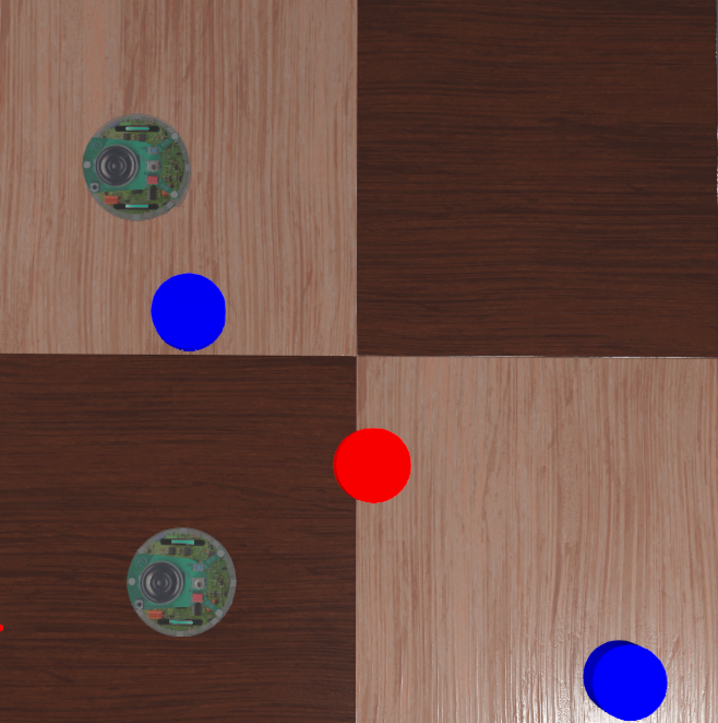
Market Based Algorithm
Auction to find the best fit for a robot :
 | Centralized | Distributed
Bid | Robots | Robots
Auction | Supervisor | Robots
rob 1 (A)
Bid Calculation (same for all methods) :
Bid = Time to go to task + Time to do Task
1
3
8
1
rob 4 (B)
Introduction
Centralized
Distributed
Conclusion

Slide 4
Contribution
World set up
Centralized
Distributed
Slides and git
Lucas MANEFF
Paul RICHARD
Jacques BENAND
Introduction
Centralized
Distributed
Conclusion

Slide 5
Centralized
Supervisor
Robots
Auction each task sequentially
Announce the Auction to all robots
Compute the bid
Assign the Task to the best bidder
Send it back to the supervisor
Notify the winning robot
Do the task
Introduction
Centralized
Distributed
Conclusion

Slide 6
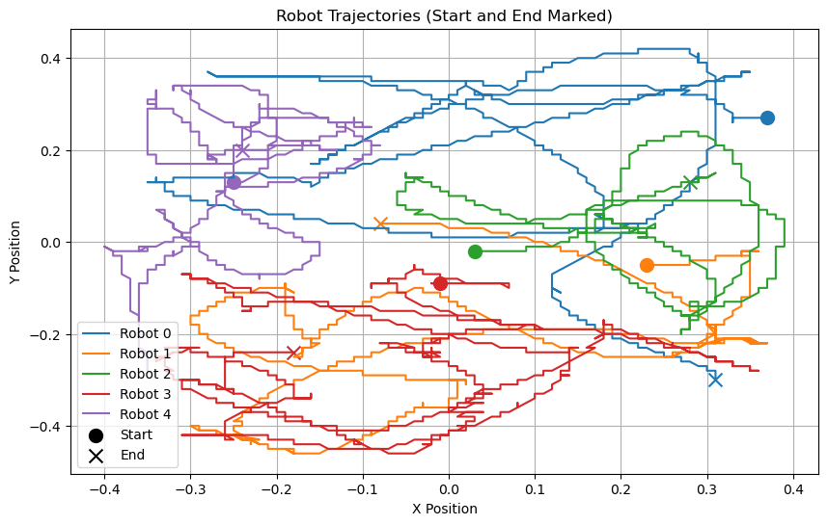
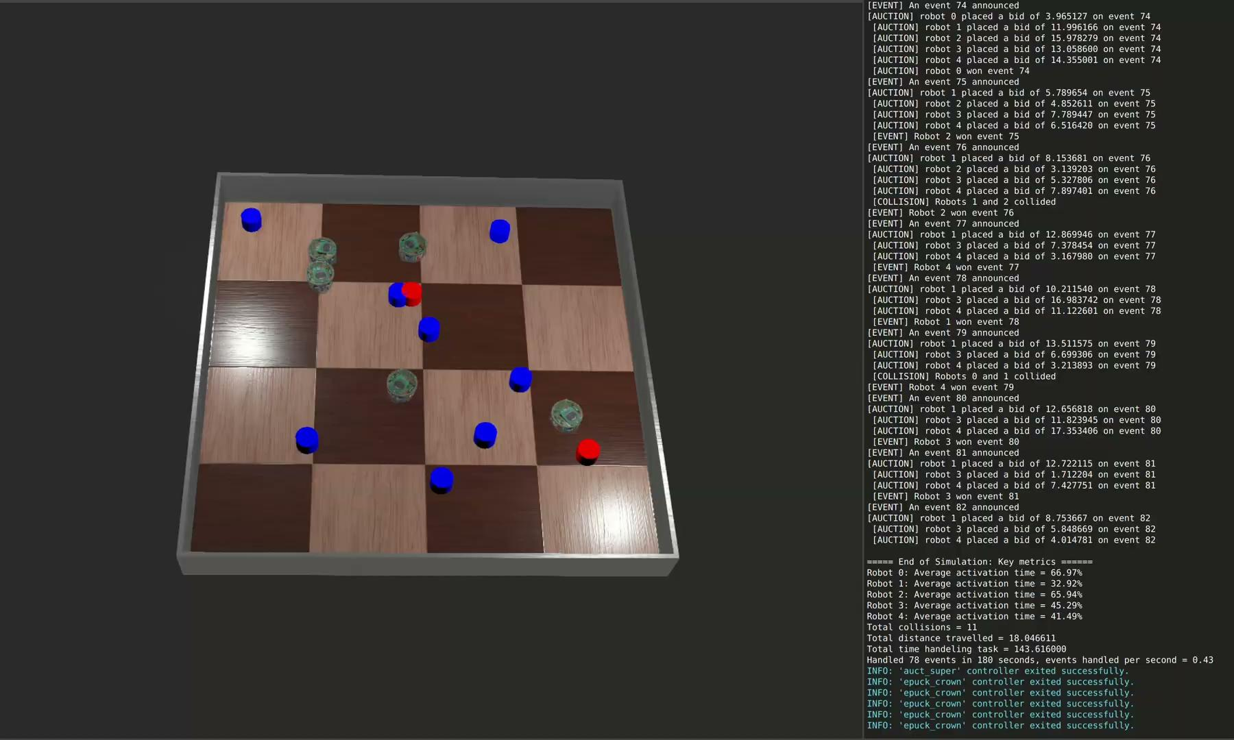
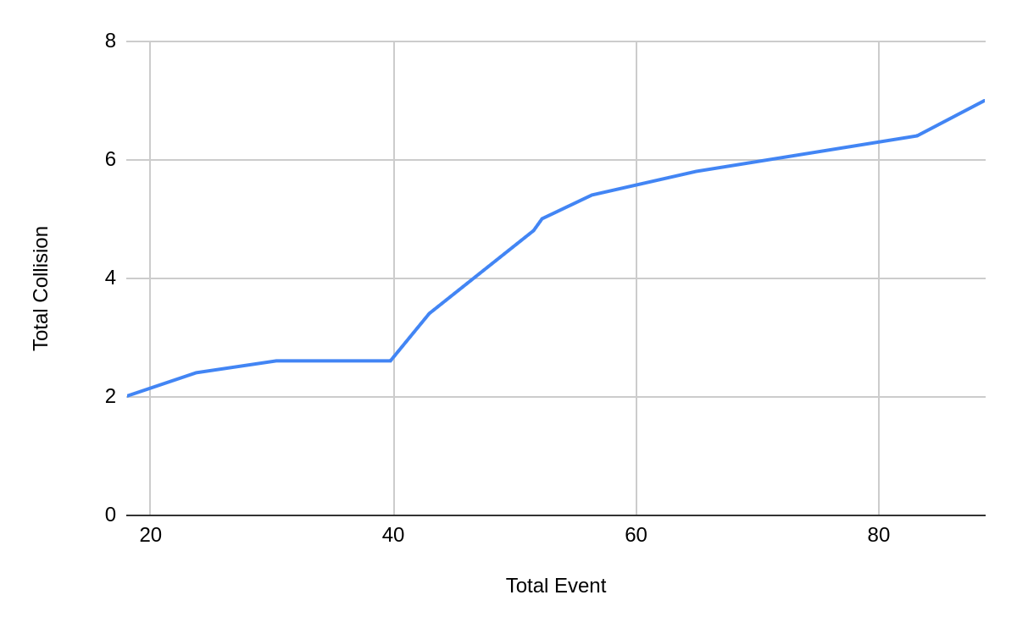
Centralized
 | Collision | Event Handled | Activation Time
Mean | 7 | 88.8 | 55.53 %
Std | 2.45 | 13.54 | 4.36 %
Introduction
Centralized
Distributed
Conclusion

Slide 7
Centralized multi step planning
Supervisor
Robots
Create bundles of 3 tasks
Announce the bundle to all robots
Compute all the possible arrangements
Assign the bundle to the best bidder
Bid on the bundle
Keep the best one
Send the task in the best order
Do all the assigned tasks
Introduction
Centralized
Distributed
Conclusion

Slide 8
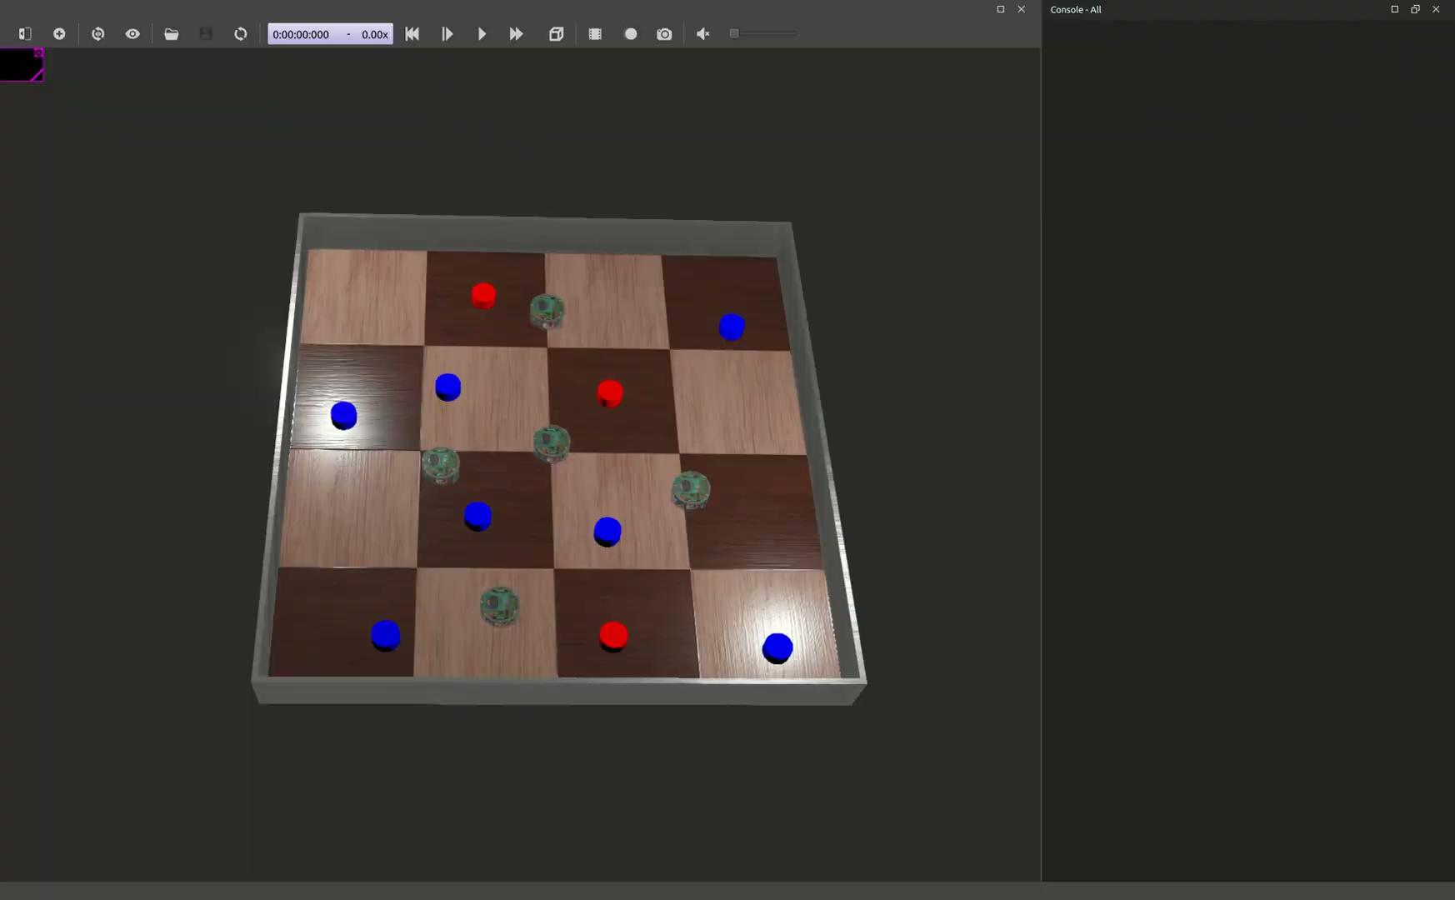
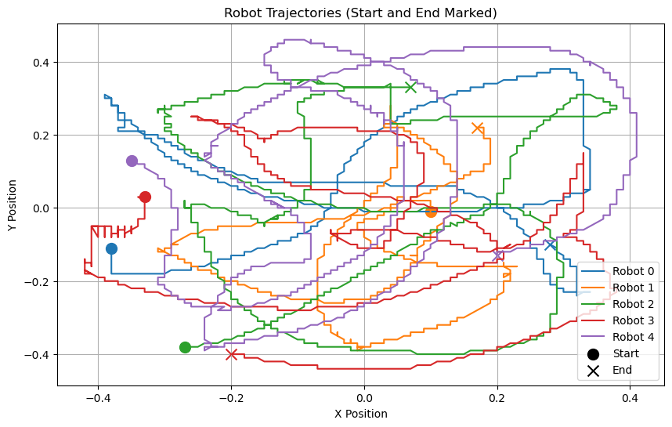
Centralized multi step planning
 | Collision | Event Handled | Activation Time
Mean | 13 | 60.8 | 63.43 %
Std | 2.73 | 7.05 | 3.67 %
Introduction
Centralized
Distributed
Conclusion

Slide 9
Distributed
Supervisor
Robots
Send new task info to every robot
Create new task
Robot loop
No
Yes
Task finished ?
Introduction
Centralized
Distributed
Conclusion

Slide 10
Distributed
Robot loop
Inter-robot communication
Compute the bid for each task
Compare the bids
Lowest bid ?
No
Yes
Notify the supervisor
Yes
Task completed ?
Do the task
Claim task
No
Introduction
Centralized
Distributed
Conclusion

Slide 11
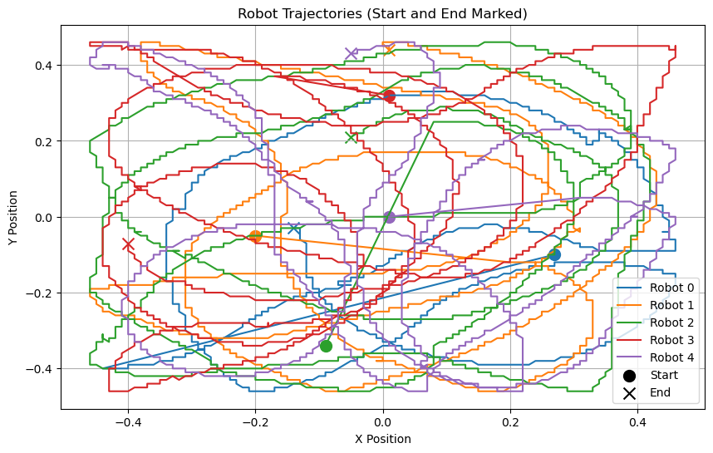
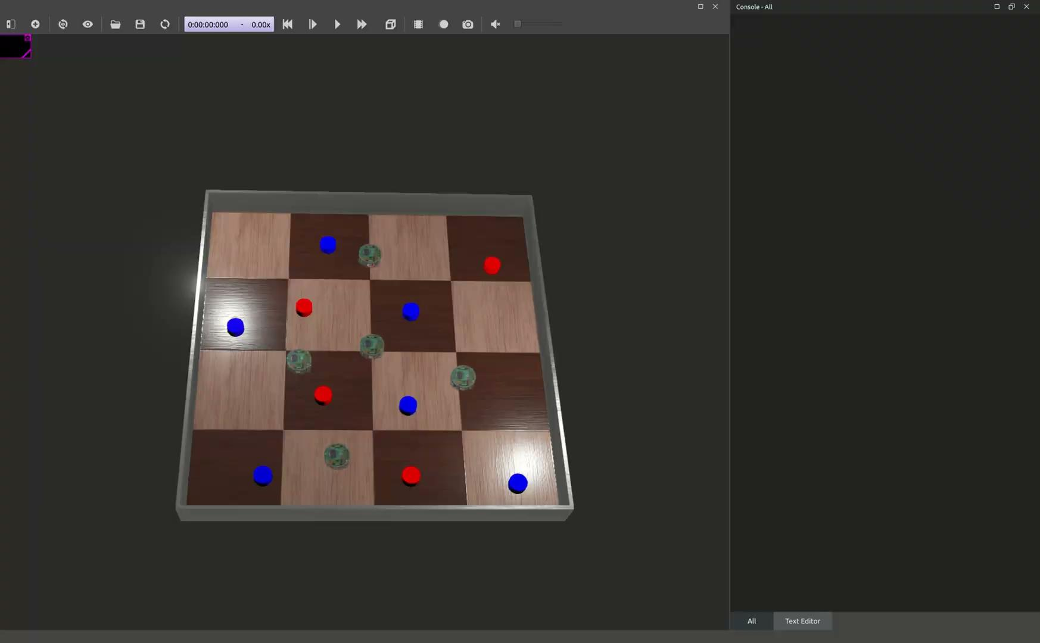
Distributed
 | Collision | Event Handled | Activation Time
Mean | 14.4 | 71.8 | 62.68 %
Std | 2.06 | 6.68 | 4.10 %
Introduction
Centralized
Distributed
Conclusion

Slide 12
Distributed multi step planning
Robot loop
Inter-robot communication
Compute the bid for each task
Compare the bids
Lowest bid ?
No
Yes
Notify the supervisor
Count number of lowest bids
Yes
Task completed ?
Go to first task of sequence with lowest bid
Compute bid for every permutation of m tasks
No
Introduction
Centralized
Distributed
Conclusion

Slide 13
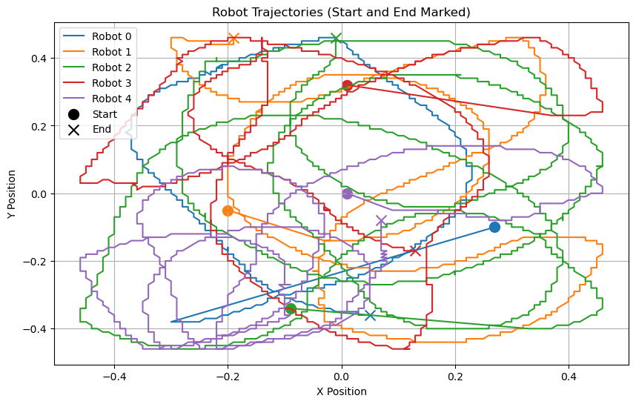
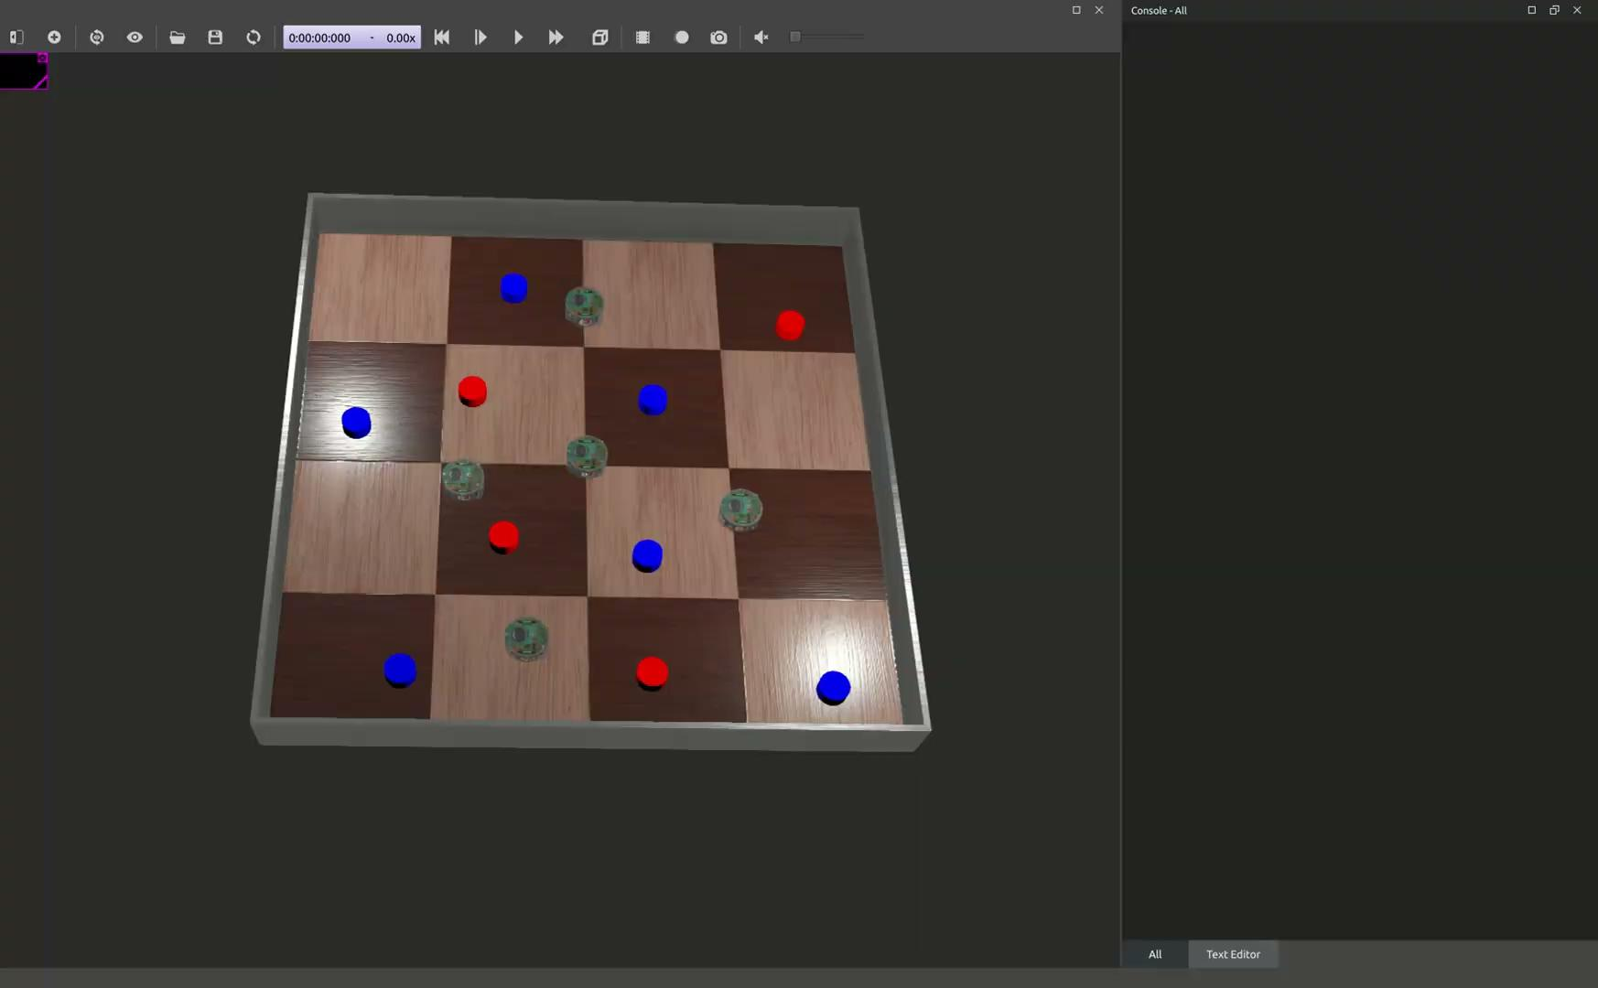
Distributed multi step planning
 | Collision | Event Handled | Activation Time
Mean | 18.8 | 80.60 | 64.61 %
Std | 4.26 | 5.50 | 4.67 %
Introduction
Centralized
Distributed
Conclusion

Slide 14
Conclusion
 | Centralized | Centralized planned | Distributed | Distributed planned
Collision | 7 | 13 | 14.4 | 18.8
Event Handled | 88.8 | 60.8 | 71.8 | 80.6
Activation time | 55.53 % | 63.43 % | 62.68 % | 64.61 %
Introduction
Centralized
Distributed
Conclusion

Slide 15
Thank you for your attention !
To visualize the videos, please refer to the PDF presentation :)
Notes:
Welcome !

Slide 16
Centralized multi step planning
Analysis
- Poor performance in terms of the number of tasks completed.
- Efficient energy usage by robots
- But sometimes leave 1-2 robots inactive (e.g., Robot 1 on the map).
New Idea (was not implemented)
- The supervisor auctions tasks sequentially and delegates optimization to the robots.
- Each robot:
- Rearranges its tasks to maximize efficiency (3-opt search).
- Bids based on the optimized task arrangement.
Introduction
Centralized
Distributed
Conclusion

